Slide 1


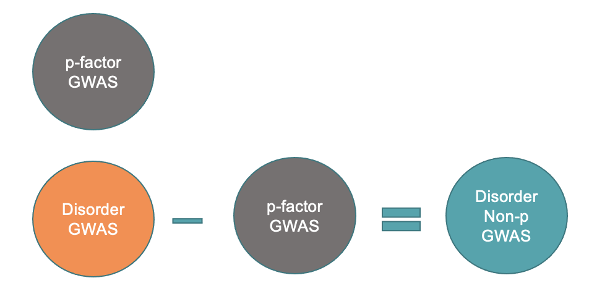
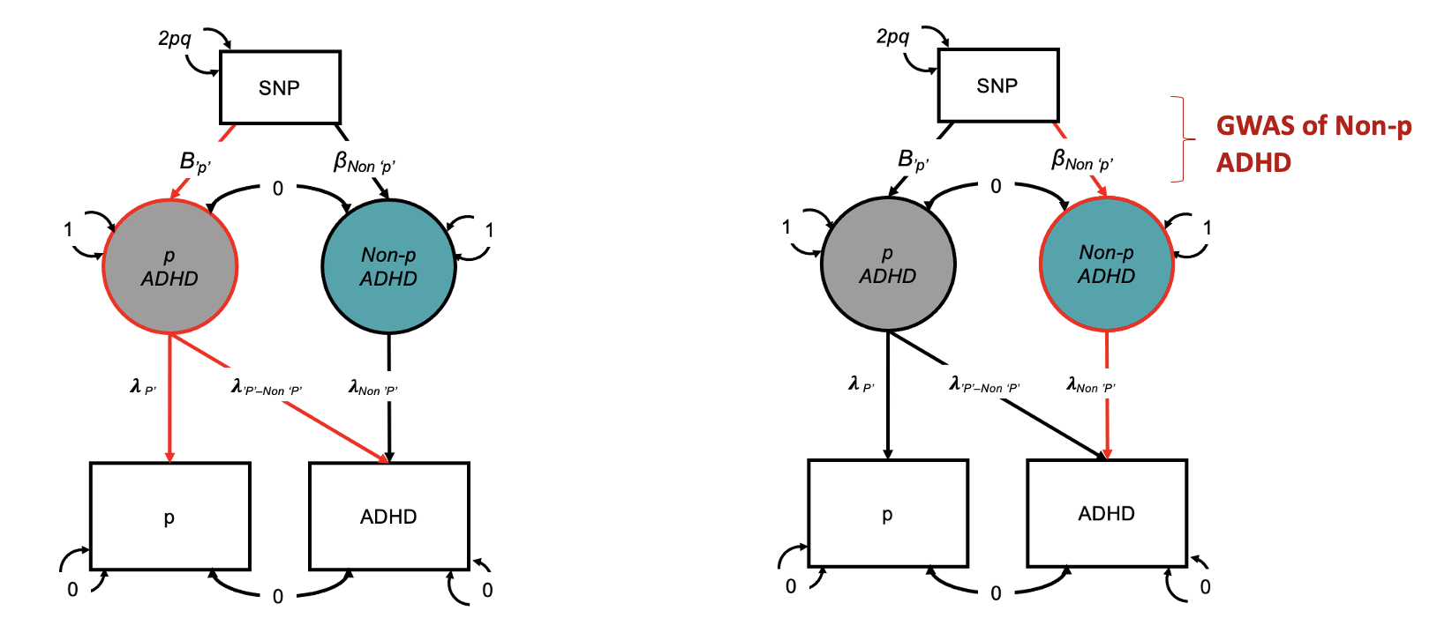
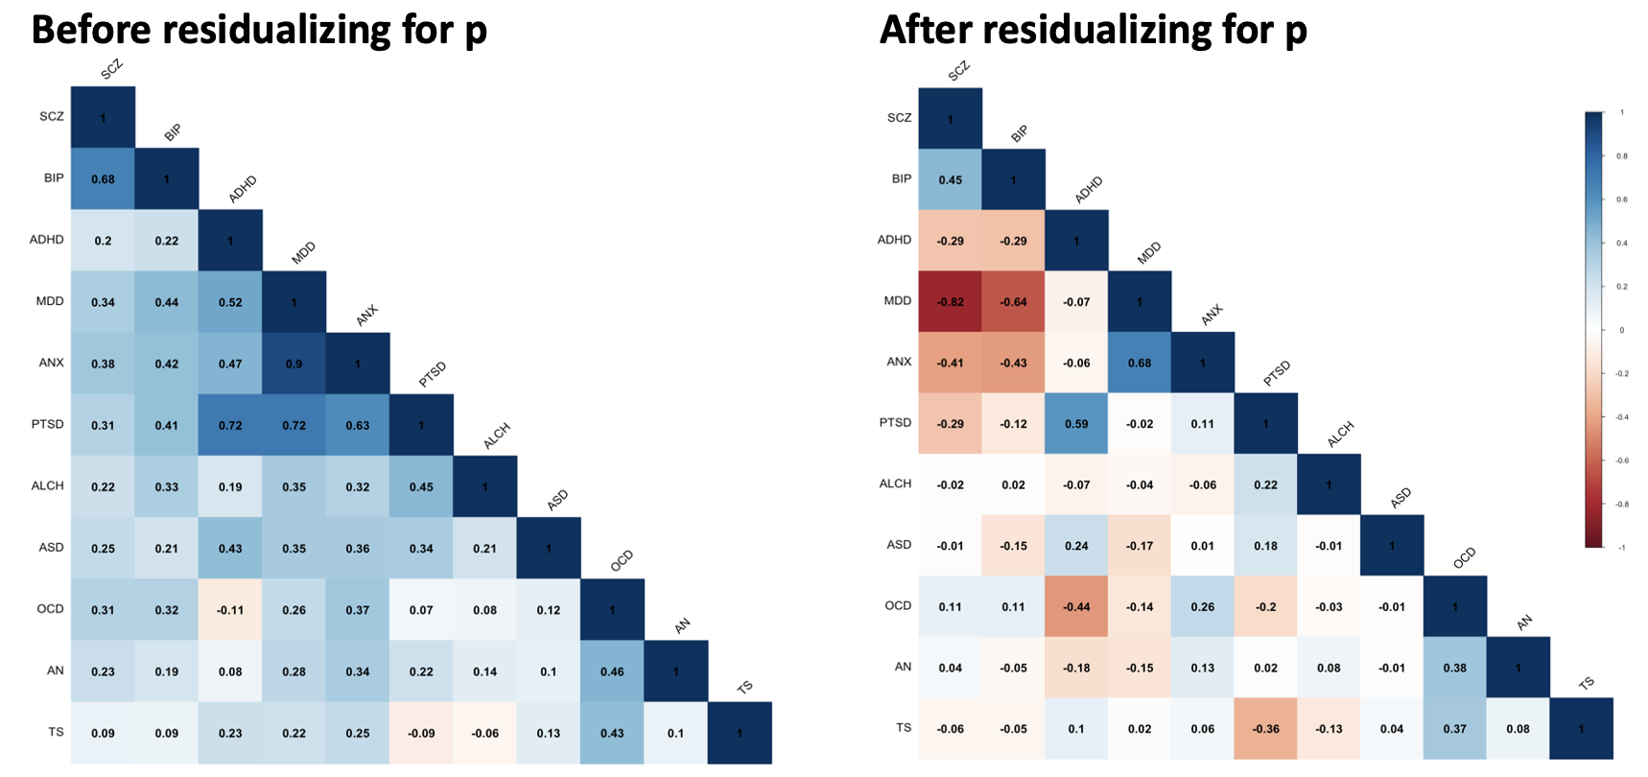
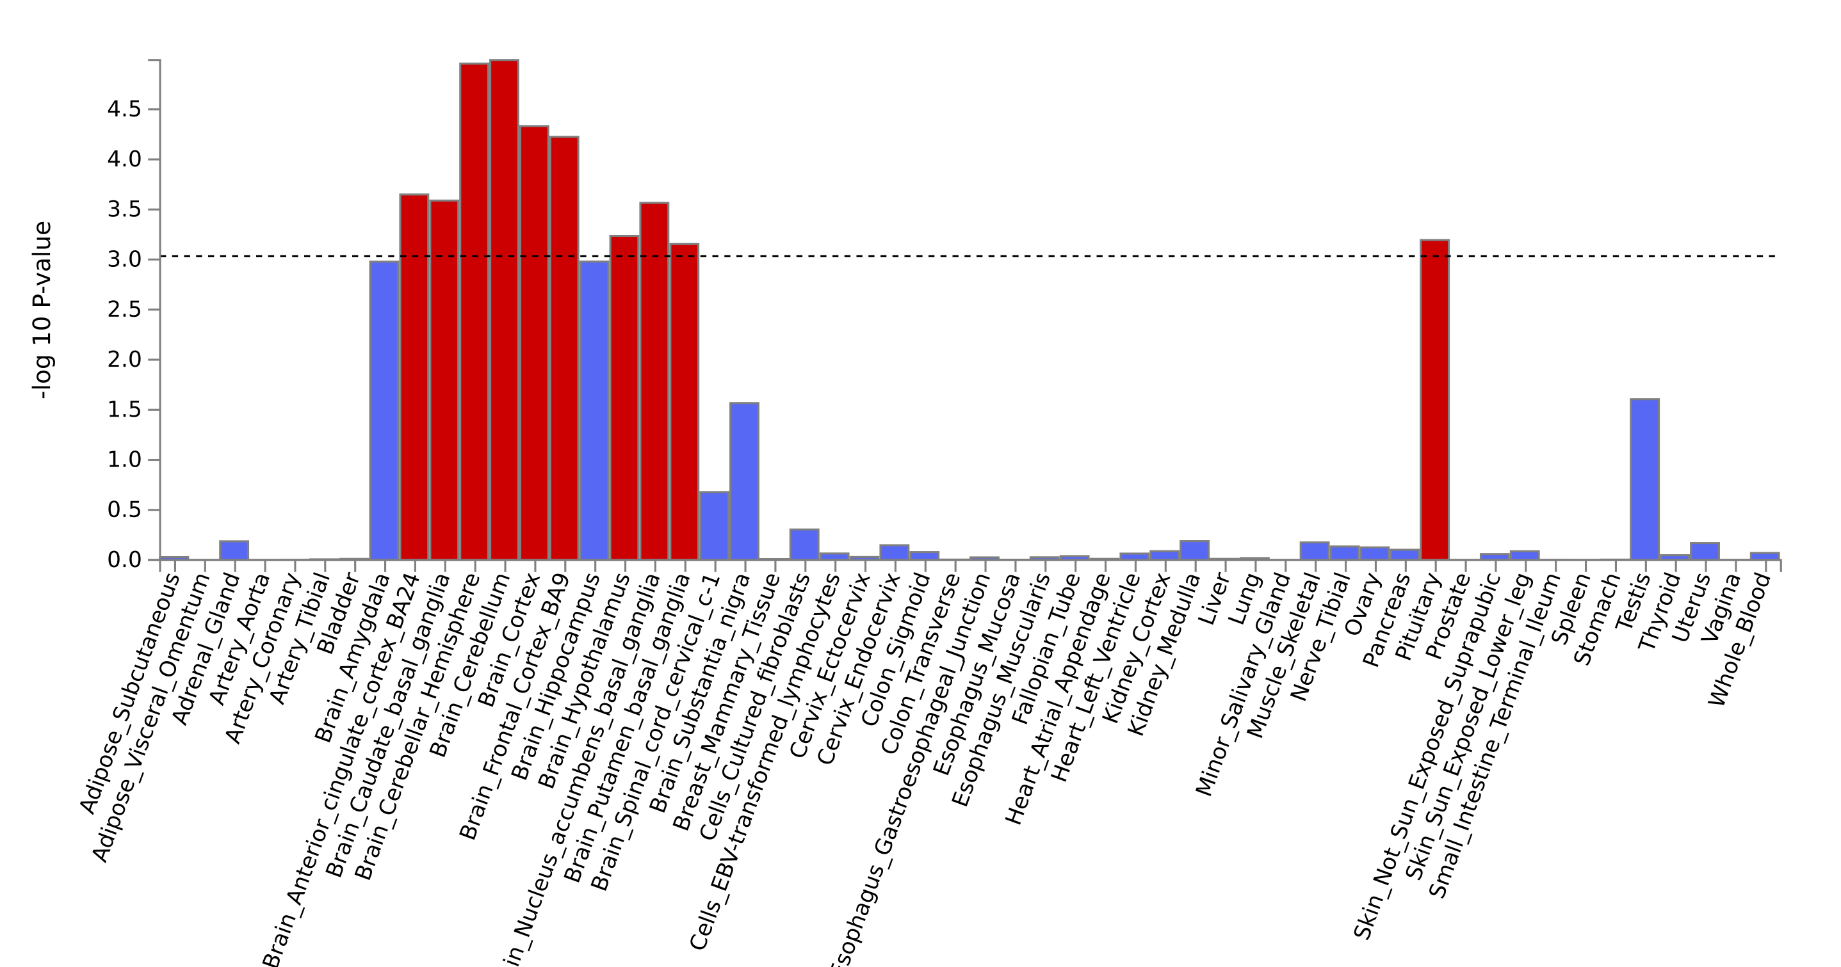
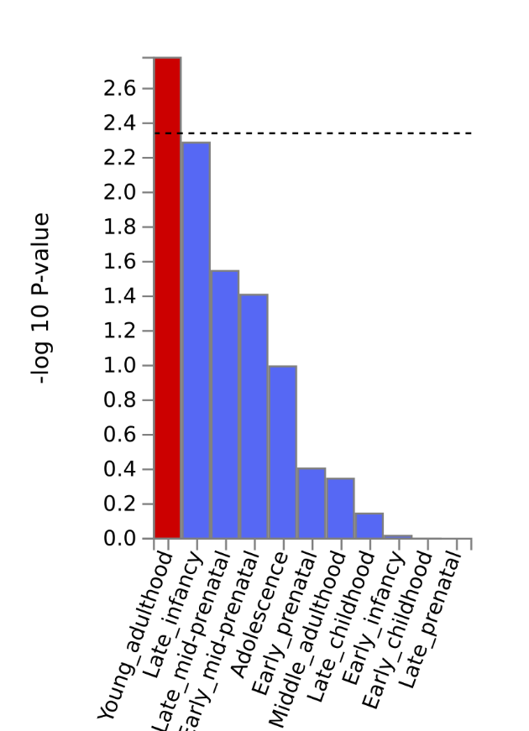
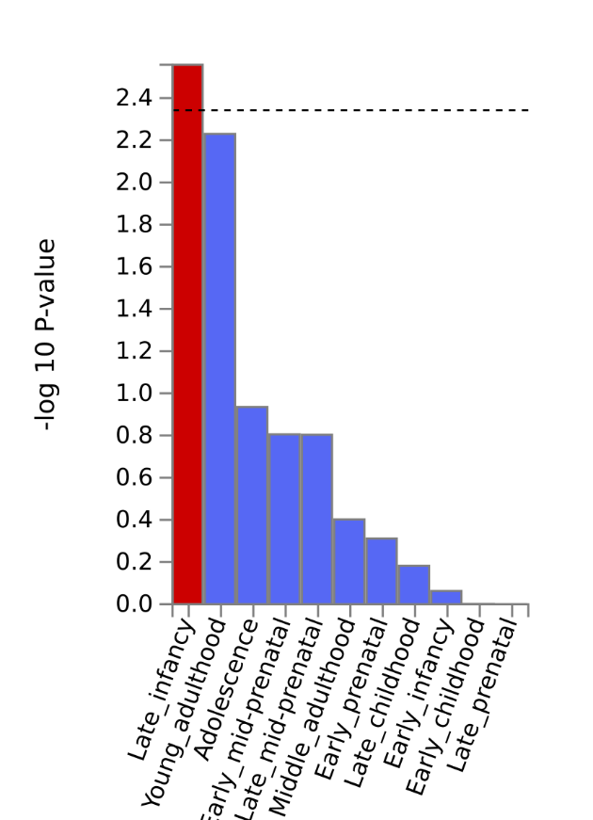
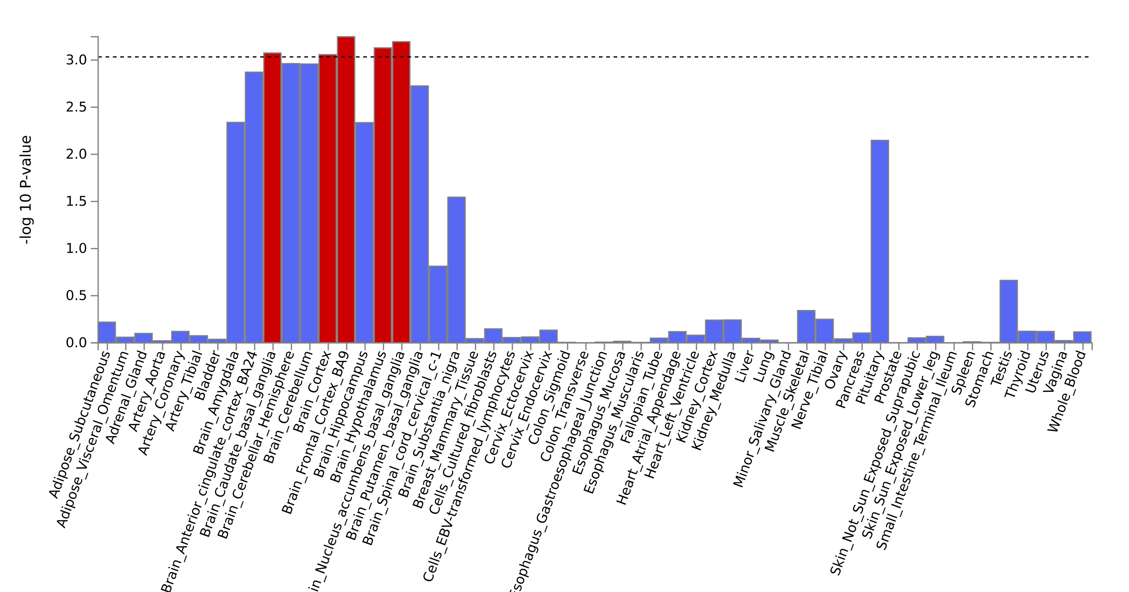
Controlling for the general psychopathology factor p in genomic research on psychiatric disorders – Part 2
Engin Keser^{1,5}, Wangjingyi Liao^{2,5}, Andrea G. Allegrini³, Kaili Rimfeld^{1,4}, Robert Plomin^{1,6} and Margherita Malanchini^{1,2,6}
¹ Social, Genetic and Developmental Psychiatry Centre, King's College London ² School of Biological and Behavioural Sciences, Queen Mary University of London ³ Department of Psychology and Language Science, University College London ⁴ Department of Psychology, Royal Holloway University of London ⁵These authors contributed equally ⁶ These authors jointly supervised the work
Recap of Part 1
Genetic Correlations with External Traits
Step 1:
Step 2:
GWAS-by-subtraction
We used GWAS-by-subtraction to subtract genetic effects associated with the genomic p-factor from the genetic effects associated with each psychiatric disorder.
Genetic correlations across the disorders
Removing transdiagnostic genetic effects significantly changed genetic relationships between psychiatric disorders.
Part 2: Downstream Analyses
Significant independent hits
Gene set enrichment analysis
LDSC
MAGMA
LD Clumping
Correlations with external traits
Different patterns of gene-set enrichment after controlling for p
Novel genetic variants associated with psychiatric disorders after controlling for p
ex: ADHD Tissue Type Enrichment
ex: BIP Brain Development Stage Enrichment
Traits | Significant independent hits | Novel SNP
SCZ | 114 | 33
BIP | 19 | 1
ADHD | 11 | 4
AN | 6 | 4
ALCH | 2 | 0
Our findings highlight that isolating p from major psychiatric disorders provides a more precise understanding of disorder-specific genetic architecture.
Notes:
Given the interesting patterns of changes we found in the rgs between the 11 psychiatric disorders, it become worth investigating the biological underpinning of the Non-ps in our Part 2 of our project, the downstream analysis.
The aim of the part 2 of the project is to investigate and compare the disorders before and after taking out p in downstream analyses.
We conducted three part of downstream analysis: genetic correlation with external traits, novel genetic loci identification, and exploring the gene and gene-set enrichment in the Nonps
Firstly we examined the genetic correlation between Non-ps and external traits in 4 categories: demographic, health, psychological and anthropometric. Then we compare the Nonp correlations with the disorder original. We applied the jack-knife correction when comparing the rgs
Then we used LD clumping to sum up the GWAS signals across the genome and identified independent significant SNPs associated with the Non-ps. We compare our newly with the original GWAS in order to identify the genetic variants not identified in the original GWAS.
Finally we used the MAGMA in FUMA to identify gene and gene-sets are significant enriched in the Non-p summary statistics, as well as how different tissue types and brain development stage samples were enriched.
RESULTS
The genetic correlation results, taking the psychological related traits as an example.
5 out of the 11 disorders showed significant changes in rgs in this categories. MDD showed the most number of changes.
Most of the changes are reduction in rgs, but with exceptions.
Reversed correlation between MDD and executive function, cognitive performance, and noncognitive skills. The original negative correlations (-0.09 to -0.18) were switched to positive (0.15 to 0.25). Also, the positive correlation between BIP and loneliness (0.11) had become negative (-0.21)
Enhanced correlation between BIP and EA (0.13 to 0.27), and between MDD and cognitive skills (-0.16 to -0.36)
Thus this demonstrate three types of changes in the psychological categories
Reduction – p was explain the original association (most of the time)
Reversed – p was masking the true associations (second often)
Enhanced – p reduced the strength of original association (least often)
4 disorders identified the novel SNPs comparing with the original.
The schizophrenia Non-p gwas have the most number of novel SNPs. The most significant novel SNP is located around a schizophrenia and education attainment related gene SCZN16-AS1.
Changes in the tissue type and brain development stage enrichment were found
The most enriched brain area in the ADHD has changed from cerebellum and hemisphere to frontal cortex.
The most enriched brain development stage of BIP has changed from young adulthood to late infancy.

